Slide 1
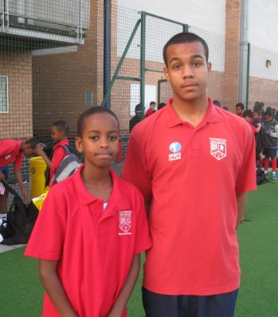
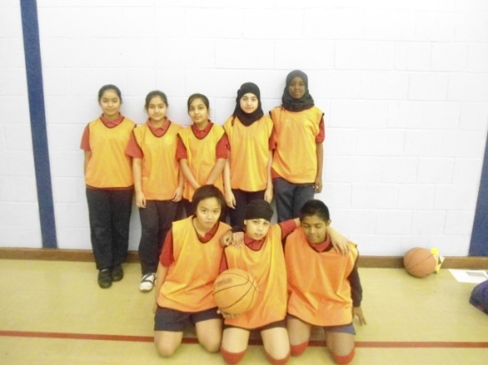
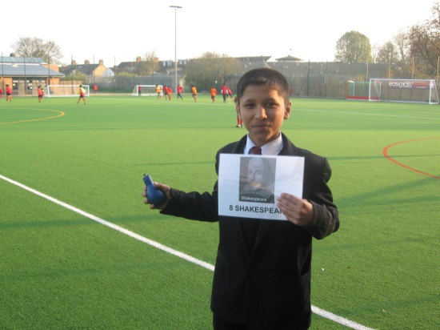
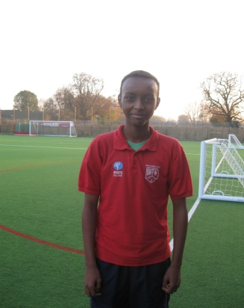
INSPIRE
House Assembly 4
Thursday 17/11/2011

Slide 2
Thought for the day
‘It's nice to be important, but it's more important to be nice.’
Reflect on this quote.
What does being nice include?

Slide 3
Overview
During assembly we will:
Look at the significance of anti bullying week
Look at upcoming house events and competitions
Meet the Inspire Captains

Slide 4
Anti-Bullying Week
Anti-Bullying Week is an annual UK event which aims to raise awareness of bullying of children and young people, in schools and elsewhere.
Organised by the Anti-Bullying Alliance (ABA).
The eighth annual event has been taking place this week, and this year the theme is:
'Stop and think – words can hurt'

Slide 5
This week is anti-bullying week…
http://www.youtube.com/watch?v=Xre8zZ_B8Mk
Notes:
Presentation by Sumaya – using 3mins of above clip in the middle of her speech.

Slide 6
Where to go for help?
If you are being bullied DO NOT suffer in silence.
The following can help you:
Form tutors, teachers, social inclusion, parents.
www.anti-bullyingalliance.org.uk
www.cybermentors.org
Childline

Slide 7
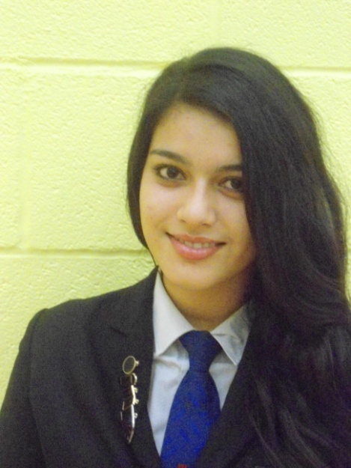
Meet the Inspire Captains.........
House Captain: Fatima Rana

Slide 8
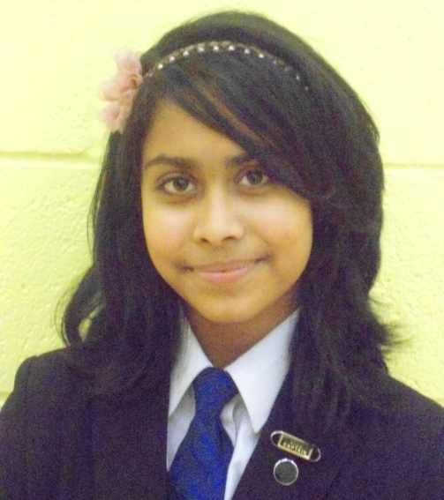
Meet the Inspire Captains.........
Vice House Captain: Shabnam Meah

Slide 9
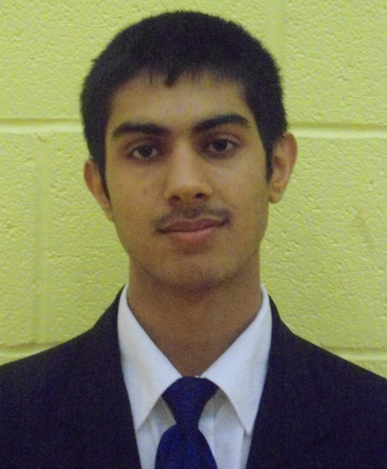
Meet the Inspire Captains.........
Sports Captains: Gurkirpal Khosa

Slide 10
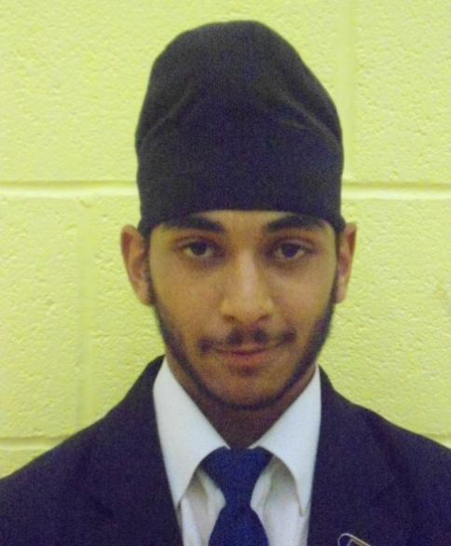
Meet the Inspire Captains.........
Science Captain: Amrit Mhay

Slide 11
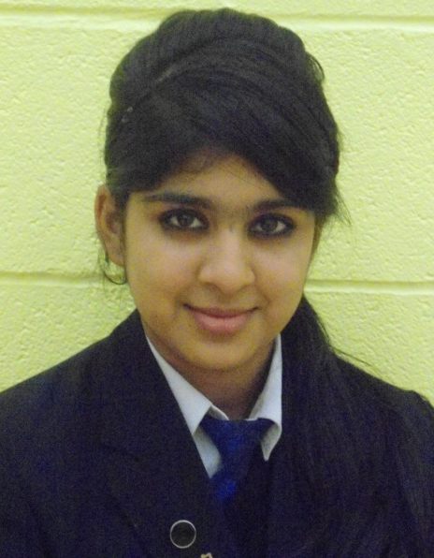
Meet the Inspire Captains.........
Arts Captain: Bavnish Matharu

Slide 12
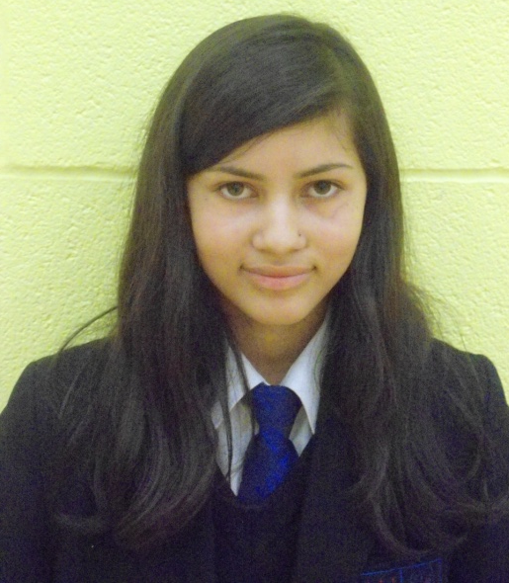
Meet the Inspire Captains.........
Community Captain: Shahjadi Ansari

Slide 13
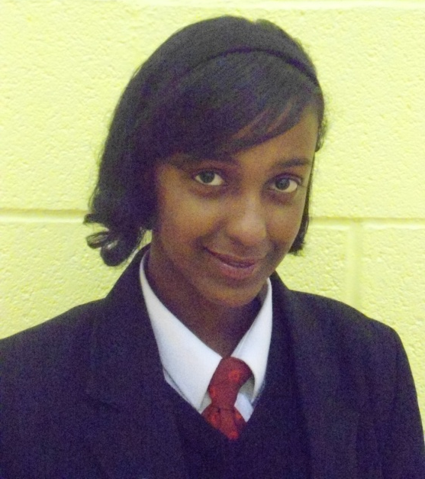
Meet the Inspire Captains.........
Humanities and MFL Captain: Ladan Muse

Slide 14
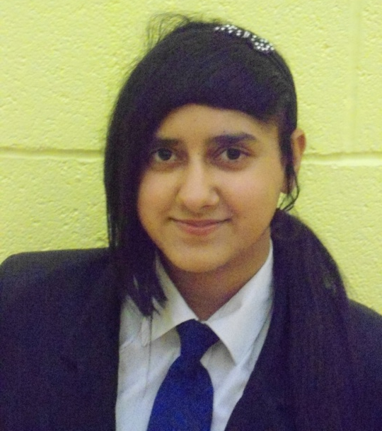
Meet the Inspire Captains.........
Maths, ICT, Business and Enterprise Captain: Simron Gill

Slide 15
How to get House Points..........
The following points scale is being used for all House events around the school.
In most sports events you get individual Tutor House Points depending on what position you finish and then more House Points based upon a combined finishing position based on the two total scores added up where the House finishes.
Other events have a one off House Point allocation based on what position the House finishes in.
There will be an update of House points as soon as events happen. This will be found on the school website or alternatively on www.fhsinspire.weebly.com

Slide 16
House Points Scale
1st Position = 50 House Points
2nd Position = 40 House Points
3rd Position = 30 House Points
4th Position = 20 House Points
5th Position = 10 House Points

Slide 17
Year 8 Inter House Football
8 Shakespeare: Runners up = 9 Tutor House Points
8 Einstein: 4th in group = 2 Tutor House Points
Inspire Final position = 2nd Position
This gave us 40 House Points & 11 Tutor House Points
Total = 51 House Points

Slide 18
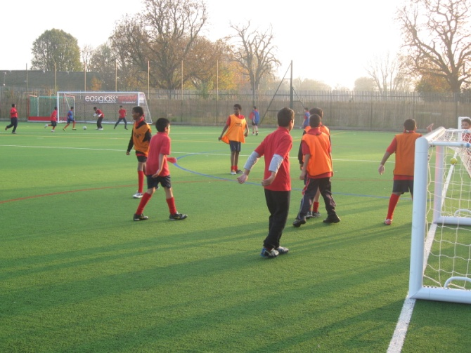
Year 7 Inter House Football
7 Shakespeare: 4th in group = 2 Tutor House Points
7 Einstein: 5th in group = 1 Tutor House Point
Inspire Final Position = 5th Position
This gave us 10 House Points and 3 Tutor House Points
Total = 13 House Points

Slide 19
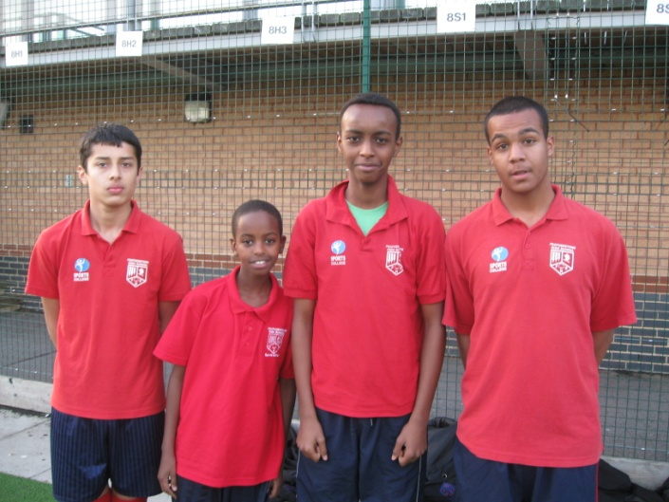
Year 9 Inter House Football
9 Shakespeare: 3rd in group = 3 Tutor House Points
9 Einstein: Overall Winners = 10 Tutor House Point
Inspire Final Position = 1st Position
This gave us 50 House Points and 13 Tutor House Points
Total = 63 House Points

Slide 20
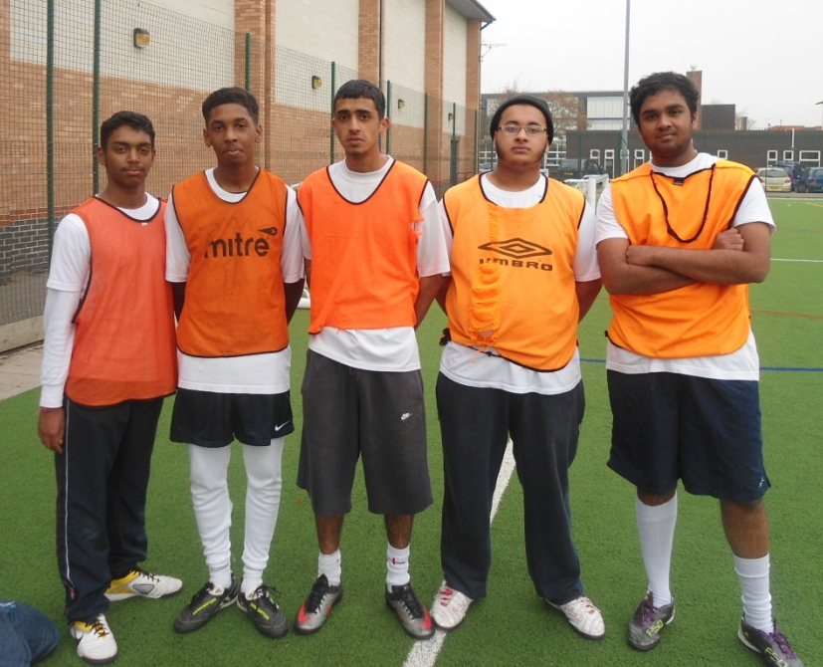
Sixth Form Inter House Sports Competition
Inspire Final Position = 3rd Position
This gave us 30 House Points
Total = 30 House Points

Slide 21
Staff Inter House Quiz
Inspire Final Position = 2nd Position
This gave us 40 House Points
Total = 40 House Points

Slide 22
House Standing so far............
Since September each House event has had specific points associated with it.
The current standings are:
5th: Honour - 151 points
4th: Equality - 160 points
3rd: Unity - 178 points
2nd: Liberty - 191 points
1st: Inspire - 197 points

Slide 23
Well done!!!!!
Well done to everybody who has taken part in any form of House event so far !
Participation is the key to success!
We need to keep participating and doing our best to maintain our position!

Slide 24
Upcoming Events/Competitions
Humanities and MFL Quiz
Date: 17th November 2011 (Today)
Location: Main Hall
Time: 16.15 – 17.15
14 members from each House will be representing Inspire.
7 Rounds: Languages, History of figure heads, A map round, Puzzle, World scramble, Multiple choice, Books and literacy
Prizes are going to be awarded for the winning House!

Slide 25
Community Volunteer Passport
This is an active volunteering scheme where you can volunteer to assist with a variety of activities around the school.
You will all be given a volunteering passport which you can use to log any minutes you volunteer around the school.
This must be signed by the teacher who you have volunteered with!
This is a competition where minutes will be added up and House Points given at the end of the term depending on how many minutes we volunteer.

Slide 26
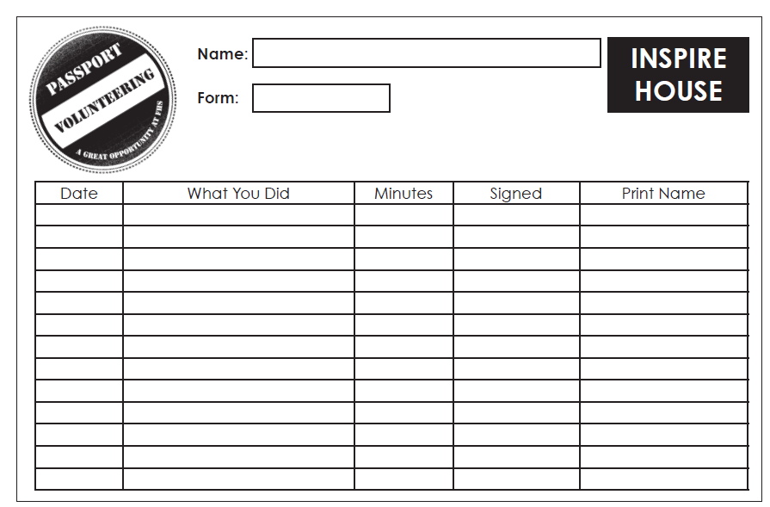
What does a Volunteer Passport Look Like?

Slide 27
Ideas for Volunteering
Reading assistance/literacy support
Mentoring pupils
Library assistance
Pupil assistance in lessons
Helping with displays and notice boards
Helping with extra curricular clubs
Assist with SSP events
Refereeing/assisting fixtures
Recycling assistance
Chicken duty
Charity work
Helping in student services
ICT Technician assistance
Website assistance
Refereeing inter house morning sports competitions
PE/Art/Science Technician
Teaching drama to Year 5 primary pupils (current 6th form project)
One to one tuition in homework club for weaker pupils
Lunch time set up assistance for PE/Art/Science etc
Home learning assistance at homework clubs

Slide 28
When does it start?
You will all be given your volunteering passports on Monday 5th December by your form tutors.
You must keep them safe.
They will be collected in before February half term
They will be collected from you at the end of each half term and minutes volunteered will be calculated.
It is now up to you to approach teachers/staff to ask if they need help!
Good luck!

Slide 29
Design your house logo,
motto and song!
Logo must be designed on a computer
Song and motto need to be linked in with the ethos or figure
Winning logo, motto and song will be used across the school!
Hand entries to student services-Deadline for entries: -Prizes for winners!

Slide 30
LITERACY HOUSE CAPTAINS NEEDED!
Do you have a talent for literacy – reading/writing/presenting?
Want the chance to work as part of a team to organise
literacy events?
Are you organised and enthusiastic?
Do you want a role of responsibility that will help you when applying for university or future jobs?
All you need to do is write an application on a maximum of 1 side of A4 and give it to your tutor or Head of House.
Literacy Captain descriptions are available from your form tutor or any Head of House.

Slide 31
Literacy Captain
Role
Work with others to plan and organise literacy events
Organise and attend meetings
Promote inter house literacy events
Contribute articles to Newsletters
Support and work with KS3 and KS4 students to improve their literacy
Make presentations in assemblies and to form classes
Collect awards on behalf of the house
Be a role model
Requirements
Be a year 12 Student
Have achieved at least a Grade C at English Language GCSE
Able to write with grammatical accuracy
Have an interest in and enthusiasm for literacy
Have been a member of a KS3/4 club
Evidence of good leadership and team work skills
Have represented FHS
Excellent communication skills
Enthusiasm for the house system, and ability to inspire others in the house
Evidence of following ground rules

Slide 32
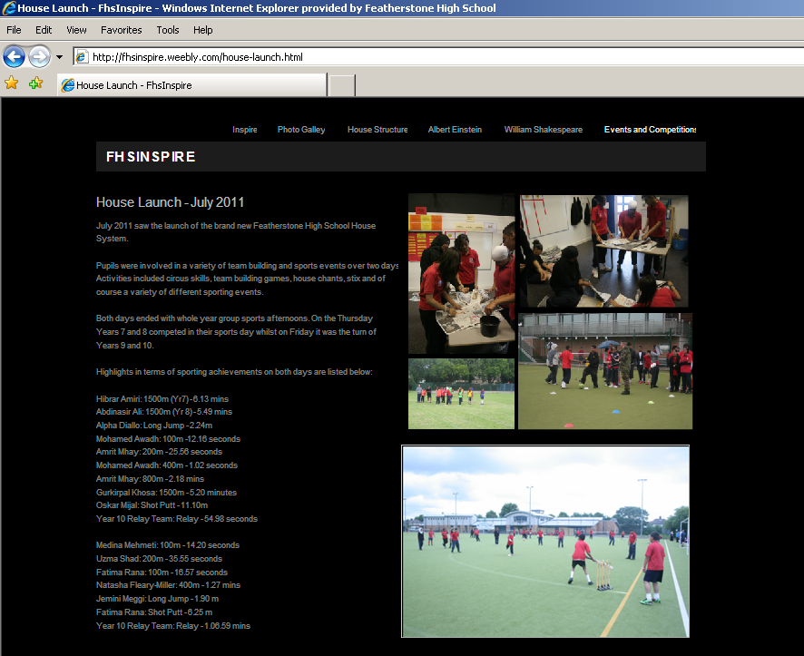
WWW.FHSINSPIRE.WEEBLY.COM

Slide 33
Children in Need
Friday 18th November 2011

Slide 34
What is Children in Need?
BBC Children In Need is a corporate charity.
Helps lives of children all over the UK.
Started in Christmas 1927.
Children in Need has a vision.
Every penny goes to disadvantaged and young children in the UK.
Pudsey is the official mascot.

Slide 35
What you can do to help?
Get Sponsored By:
Doing a run, walk or cycle.
Staying silent for a time period.
Selling cakes.
Wearing fancy dress
Colouring your hair
Growing a moustache
Shaving your hair off!

Slide 36
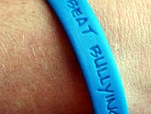
What is happening at school?
Tuesday: Anti-bullying wristbands sold at lunchtime.
Friday: Cake sale at lunchtime.
Friday: Copper drive, so bring in all your spare copper coins.
Friday: Children in Need Film night in the main hall.

Slide 37
Before you leave....................
Consider the following before you leave:
You all know the difference between right and wrong.
All of your actions and words have positive and negative effects on others.
Please remember that nobody is perfect and therefore nobody has the right to bully another person.
Participation is the key to success!

