Slide 1
House Captains Meeting
17th January 2012

Slide 2
Agenda
Ice breaker Quiz
House based discussion on effective teams
Outline of the year
Arts Competition- Miss Harvey
Science Competition- Mr Aujla
Community Passport- Mr Sangha
Getting into you committee groups

Slide 3
Quick Quiz
What year were your figure heads born?
How many pupils are in you house, to the nearest 10?
How many sports will there be at the London 2012 Olympics?
For the scientists: why would physics text books need to be re-written with regards to light?
What is the first name of the famous cubist Picasso?
Which successful business man’s first Business was a magazine called ‘Student’ at the age of 16?
What is the name of the stone that helped us to understand hieroglyphics, and was the first translation tool?
What do you call the attribution of human emotions or characteristics to inanimate objects or to nature; for example, angry clouds; a cruel wind.

Slide 4
Answers
Curie:1904 Mandela: 1936 Einstein: 1879 Shakespeare: 1564 Roosevelt: 1884 King:1929 Gandhi: 1869 Parks:1913 Owens:1913 Churchill: 1874
Unity: 285 Equality: 289 Inspire:314 Honour: 311 Liberty:306
31 sports
Neutrinos are faster that photons (light)
Pablo Picasso
Richard Branson
The Rosetta stone
Pathetic fallacy

Slide 5
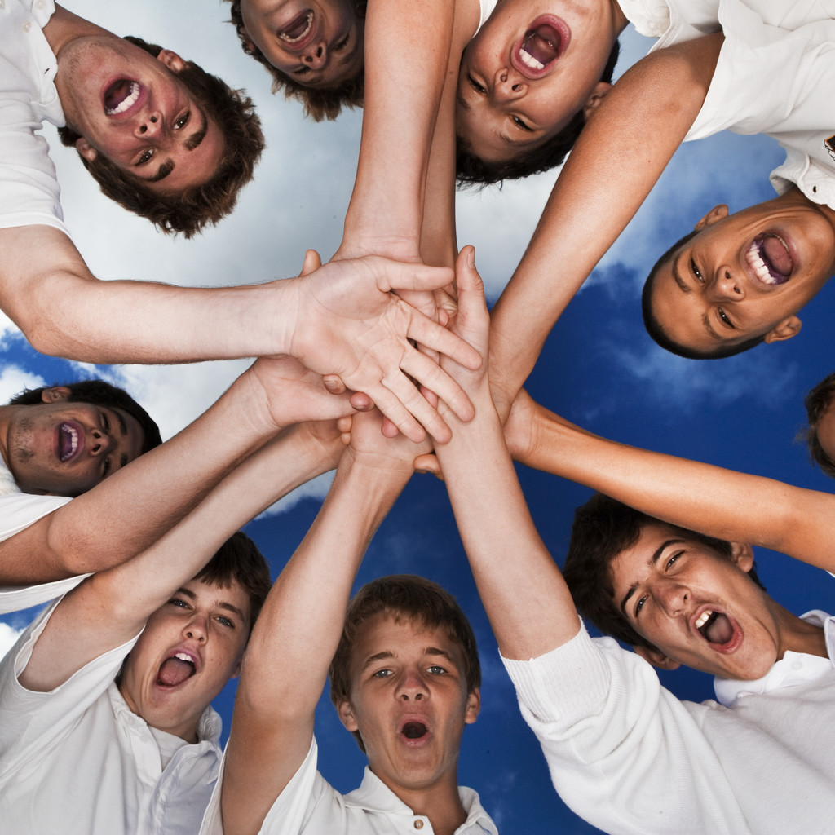
What makes and effective team?
In your house teams with you Head of House discuss
5 mins
Feedback

Slide 6
4 key factors for an effective team
Openness
Bringing up concerns
Discussing ideas
Trust
Taking responsibility
Supportiveness
Friendship
Helping each other
Encouraging others
Taking action
Being proactive, not reactive
Identifying areas for improvement and addressing them
Personality
Positive energy
Smiling
Enjoy your role
Making people feel comfortable, approachable

Slide 7
How can we improve as team
Consider the factors that make a good team
In house groups identify the areas that you could focus on
Set yourselves a target for the next term.
All good teams need a clear Vision
In your houses cone up with your vision for the year.

Slide 8
Smiles beget smiles, complaints provoke complaints; personal disclosures lead to further disclosures; and cynicism spreads faster than a cold.
F. LaFasto and K Larson (2001)

Slide 9
Upcoming Events
January 19th Arts photography workshop
January 30th Arts Competition deadline
6th and 7th February Arts competition Gallery
February 9th Collection of community passports
February 23rd Science Competition
April- Business, Maths and ICT Competition- Ms Toms
July 12th and 13th- Team Building and Sports days- All HoH

Slide 10
Arts Competition- Miss Harvey

Slide 11
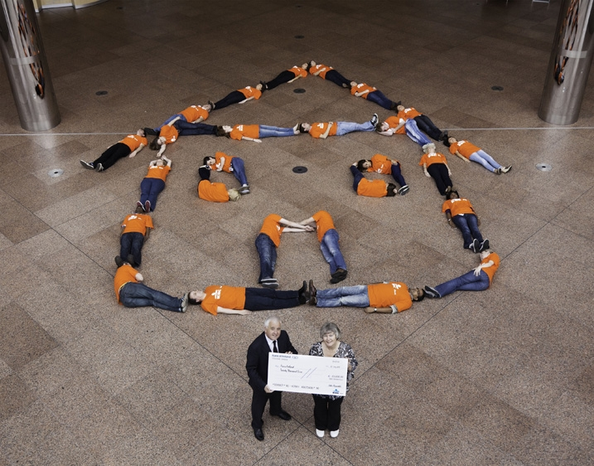
Science Competition- Mr Aujla
During Science week
Teams of 14 (2 pupils per year)
Building ‘Houses’
Engineering Challenge

Slide 12
Community Volunteer Passport- Mr Sangha
This is an active volunteering scheme where you can volunteer to assist with a variety of activities around the school.
You will all be given a volunteering passport which you can use to log any minutes you volunteer around the school.
This must be signed by the teacher who you have volunteered with!
This is a competition where minutes will be added up and House Points given at the end of the term depending on how many minutes we volunteer.

Slide 13
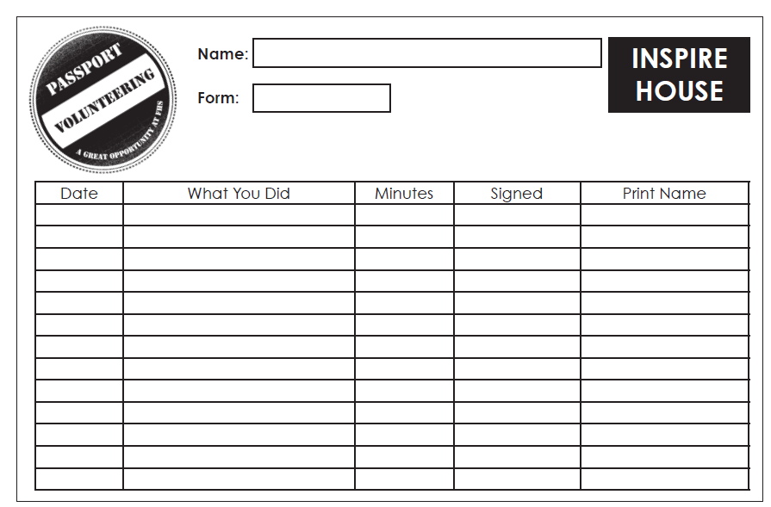
What does a Volunteer Passport Look Like?

Slide 14
Committee groups
Get into your groups
Captains and Vice
Sports
Science
Arts
Maths, ICT and Business
MFL and Humanities
Community
Literacy
Discuss in your groups what your responsibilities you have for the next year

