Slide 1
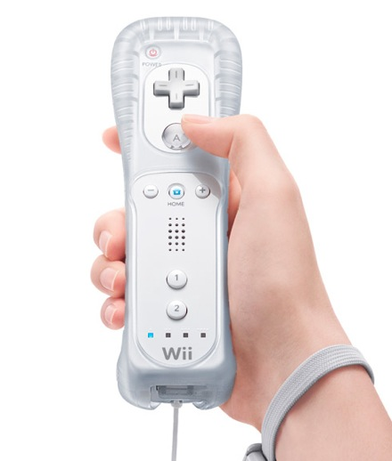
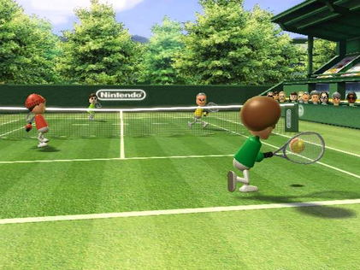
Inter-House
Challenge!

Slide 2
Who can play?
Compete in teams to become Wii® Tennis champions and earn your House some serious points!
Open to years 7, 8, 9 and 10
Each House to be represented by 4 teams, each made up of 2 pupils:
2 teams made up of a combination of year 7/8 pupils
2 teams made up of a combination of year 9/10 pupils
For example:
Honour Team 1: 7 Mandela + 8 Mandela
Honour Team 2: 7 Curie + 8 Curie
Honour Team 3: 9 Mandela + 10 Mandela
Honour Team 4: 9 Curie + 10 Curie
Notes:
Edit last bit to include names of your own House forms

Slide 3
The Competition
League style competition:
Two separate leagues for 7/8 teams and 9/10 teams
Week 1: 7/8 competition, 11th June – 15th June
Week 2: 9/10 competition, 18th June – 22nd June
Teams play every other team in their league once during lunch times on the large projector in the Main Hall! (3 points for a win and 1 for a loss)
Points each team earns are combined and the House with highest total of points wins the competition

Slide 4
The Schedule
E.g.
Each team will play during 4 out of 5 lunches during a week of competition.
Two games per team when they play
....don't worry, you will also have time for lunch!

Slide 5
How to Enter
One pupil per form will go forward to represent their House
If more than one pupil would like to take part from a form, then one pupil will be selected at random – so equal chance for all to be chosen!
If you miss out this time around, then don't worry, other opportunities, playing other games will be available.
Deadline to enter is Wednesday 30th May – House Captains/Heads of House will come around to collect names of those wanting to take part

