Slide 2
Sade speaking if not present
http://www.youtube.com/watch?v=fvr3i2l8En0

Slide 3
Connector: Sade!
Sade Bashorun – 2nd runner up for Ealing Jack Petchey Speak Out competition
Listen to her speech
What does she do well?

Slide 4
Objectives and outcomes
Objectives
To support you in planning and delivering public speeches
Outcomes
To have discussed the key ingredients for good public speaking
To have practised putting together and delivering a short speech

Slide 5
Activity
There are some agreed key ingredients for effective public speaking
On your table are 10 cards with an aspect of public speaking on it
In your houses, work as a group to decide which order they should be in
1 = most important aspect of public speaking
10 = least important aspect of public speaking

Slide 6
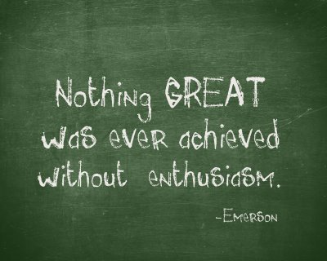
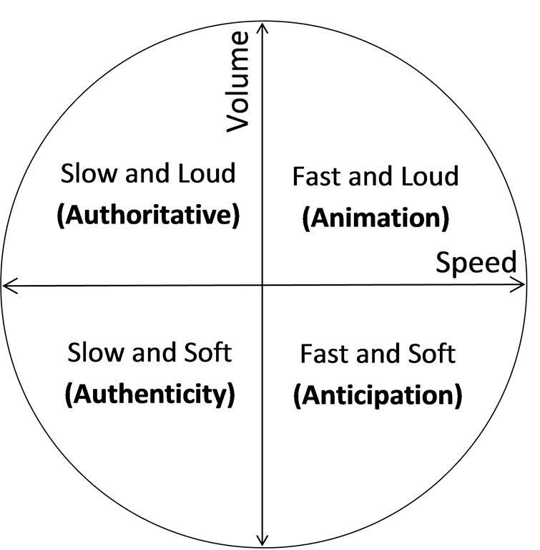
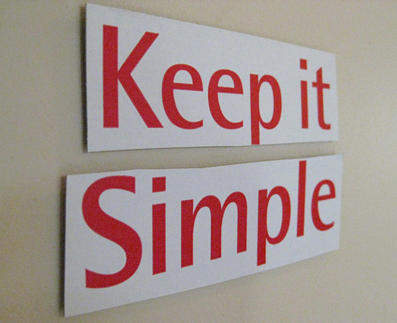

Slide 7
Feedback
Which order did you put them in? Why?
Be Yourself
Vocal variety – pace, tone and volume
Structure
Timing
Practise practise practise
Keep it simple
Be enthusiastic
Slowing down!
Speaking up!
Eye contact

Slide 8
Over to Mr Austin
Help from a master of public speaking

Slide 9
Tips to overcome the nerves
Remember: Your audience wants you to succeed
Practice makes perfect – know your material
Have a short and simple introduction and conclusion – memorise them
Imagine yourself speaking – visualise success
Breathe!
Take every opportunity to speak

Slide 10
Activity
Prepare a short speech on your role – I will model
Role
Name
Short introduction
Thank you for listening
My role
Greeting
Short conclusion
What I want to achieve as a ___ captain
What order
should they be in?
Remember structure.

Slide 11
Review
In pairs or threes -present your speech to your partner
Partners please provide feedback
www: e.g. structure; eye contact
Target: e.g. Slow down; vocal variety
Write your target down on the target card

Slide 12
Get speaking!
“There are only two types of speakers in the world. 1. The nervous and 2. Liars”
Mark Twain
“Your audience doesn't want you to be perfect - they want you to be present."
Bill Gove

